Slide 1


SQL Analysis on FDA data
Completed by:
Rohan Sharma
www.linkedin.com/in/sharmarohan659

Slide 2
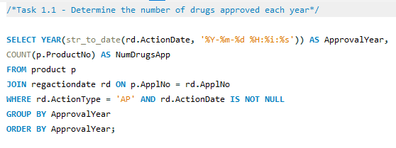
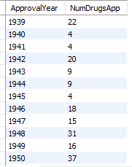
Task – 1: Identifying Approval Trends
SQL Analysis
Question - 1
Determine the number of drugs approved each year and provide insights into the yearly trends.
Input
Output

Slide 3
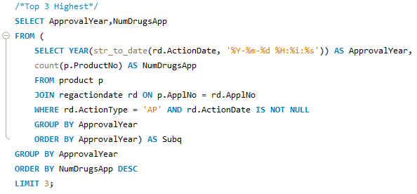

Task – 1: Identifying Approval Trends
SQL Analysis
Question - 2
Identify the top three years that got the highest and lowest approvals, in descending and ascending order, respectively.
Input
Output

Slide 4
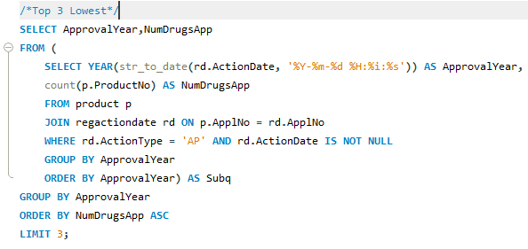

Task – 1: Identifying Approval Trends
SQL Analysis
Question - 2
Identify the top three years that got the highest and lowest approvals, in descending and ascending order, respectively.
Input
Output

Slide 5
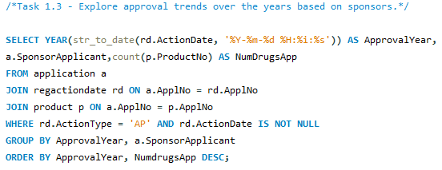
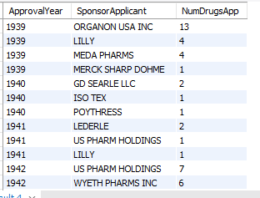
Task – 1: Identifying Approval Trends
SQL Analysis
Question - 3
Explore approval trends over the years based on sponsors.
Input
Output

Slide 6
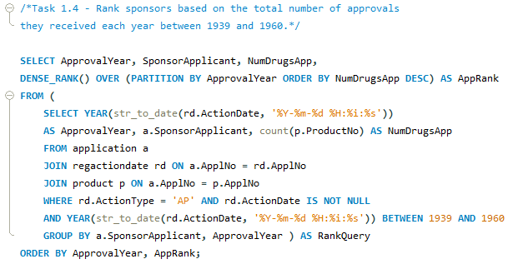
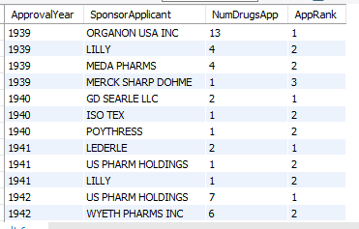
Task – 1: Identifying Approval Trends
SQL Analysis
Question - 4
Rank sponsors based on the total number of approvals they received each year between 1939 and 1960.
Input
Output

Slide 7
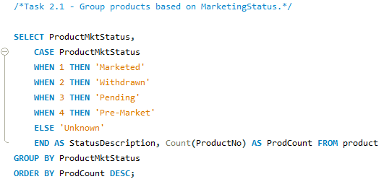

Task – 2: Segmentation Analysis Based on Drug Marketing Status
SQL Analysis
Question - 1
Group products based on MarketingStatus. Provide meaningful insights into the segmentation patterns.
Input
Output

Slide 8
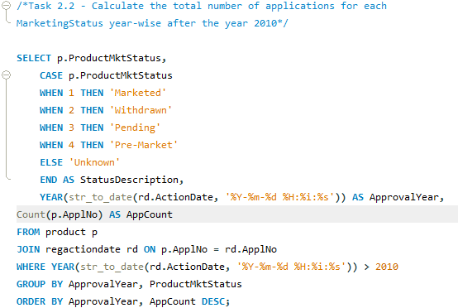
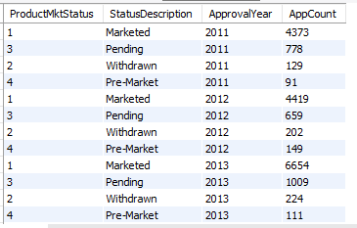
Task – 2: Segmentation Analysis Based on Drug Marketing Status
SQL Analysis
Question - 2
Calculate the total number of applications for each MarketingStatus year-wise after the year 2010.
Input
Output

Slide 9
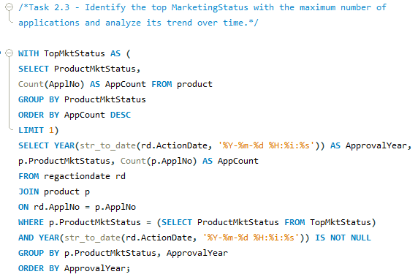
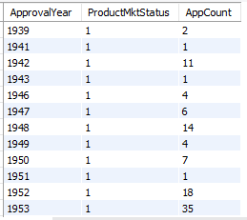
Task – 2: Segmentation Analysis Based on Drug Marketing Status
SQL Analysis
Question - 3
Identify the top MarketingStatus with the maximum number of applications and analyze its trend over time.
Input
Output

Slide 10
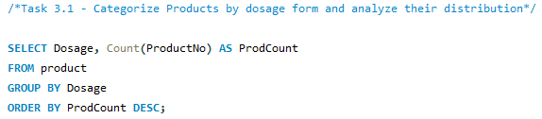
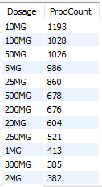
Task – 3: Analyzing Products
SQL Analysis
Question - 1
Categorize Products by dosage form and analyze their distribution.
Input
Output

Slide 11
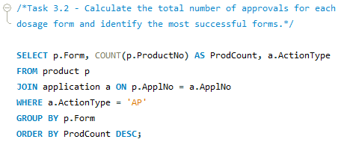
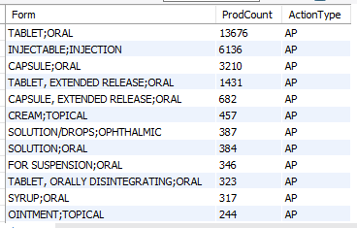
Task – 3: Analyzing Products
SQL Analysis
Question - 2
Calculate the total number of approvals for each dosage form and identify the most successful forms.
Input
Output

Slide 12
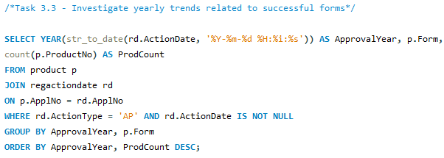
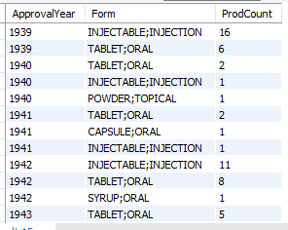
Task – 3: Analyzing Products
SQL Analysis
Question - 3
Investigate yearly trends related to successful forms.
Input
Output

Slide 13
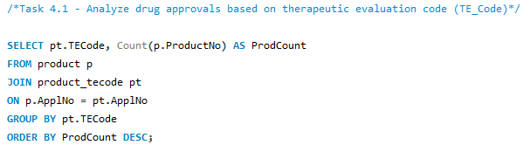
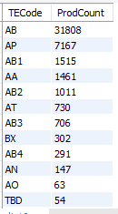
Task – 4: Exploring Therapeutic Classes and Approval Trends
SQL Analysis
Question - 1
Analyze drug approvals based on therapeutic evaluation code (TE_Code).
Input
Output

Slide 14
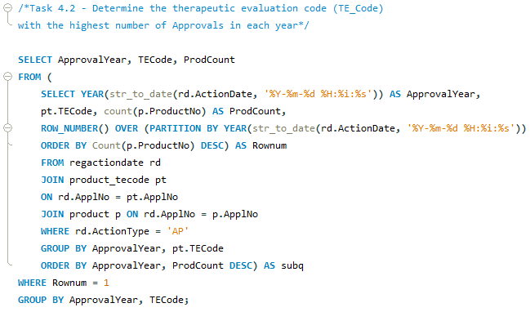
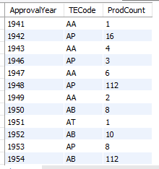
Task – 4: Exploring Therapeutic Classes and Approval Trends
SQL Analysis
Question - 2
Determine the therapeutic evaluation code (TE_Code) with the highest number of Approvals in each year.
Input
Output

